Slide 1

Scarcity to Abundance
Presented by: Mohammed Marchud Elie Charbel Jana Rima Maroun Eid Lynn Audi
GNE 301 - Final Presentation

Slide 2
Table of Content
01
02
03
Introduction
Methods
Results
04
05
06
Discussion
Solutions
Recommendations

Slide 3
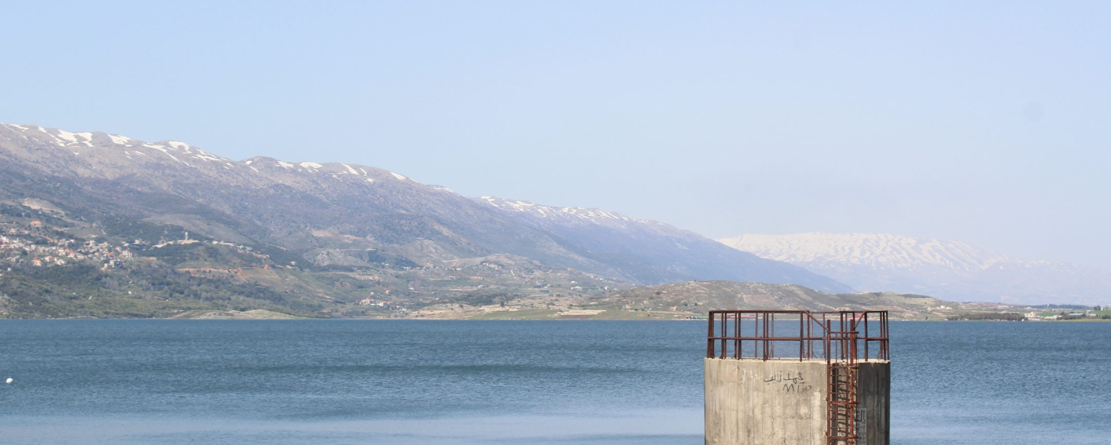
01
Introduction

Slide 4
Timeline
2010
2019
2024
Droughts
Economic Crisis
Present

Slide 5

02
Methodology

Slide 6
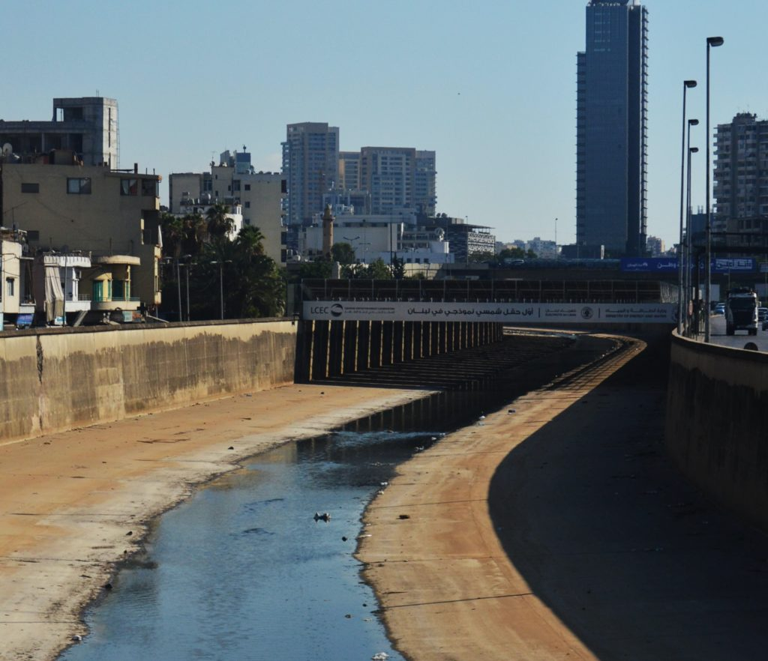

Aim
Acknowledging the current situation of water in Lebanon

Slide 7




Collected Data
Place
Method
Lebanese American University, Byblos
Google Sheets
Questionnaire
Participants
Composition
49 participants
15 questions

Slide 8
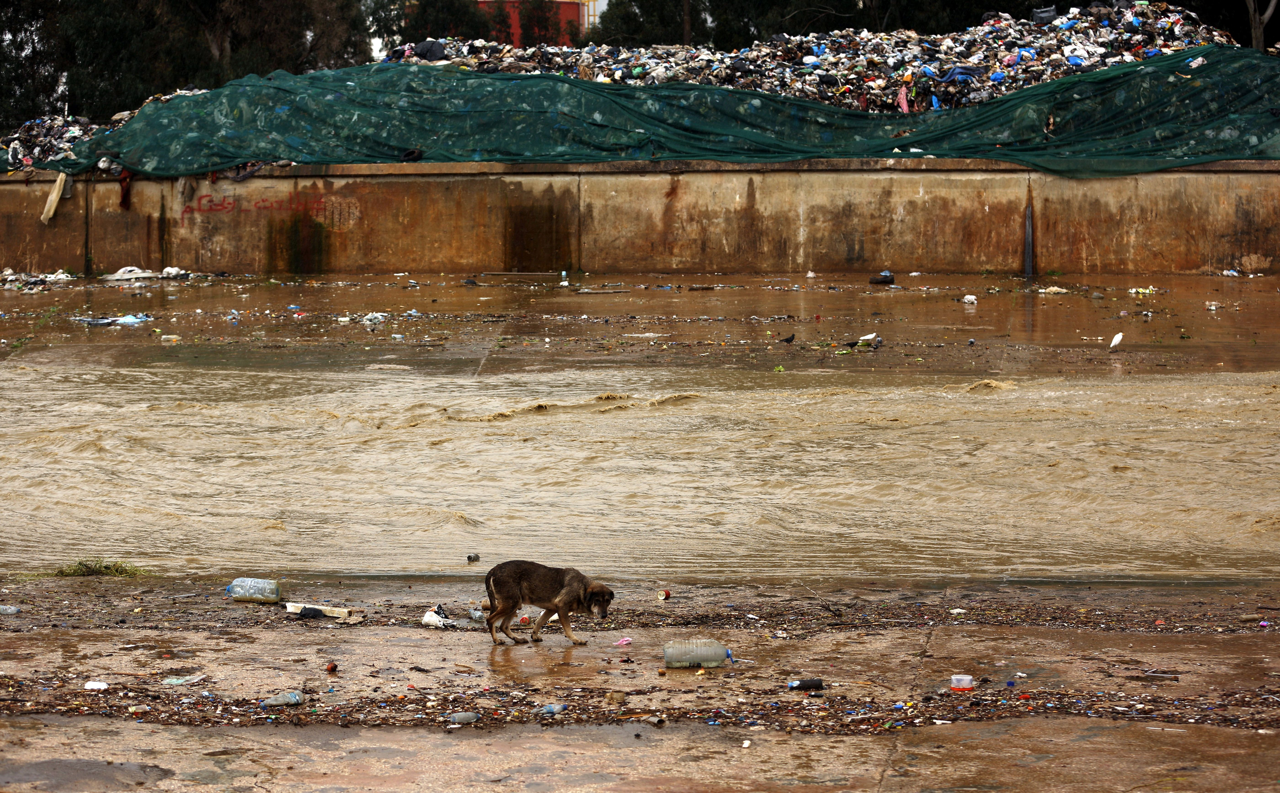
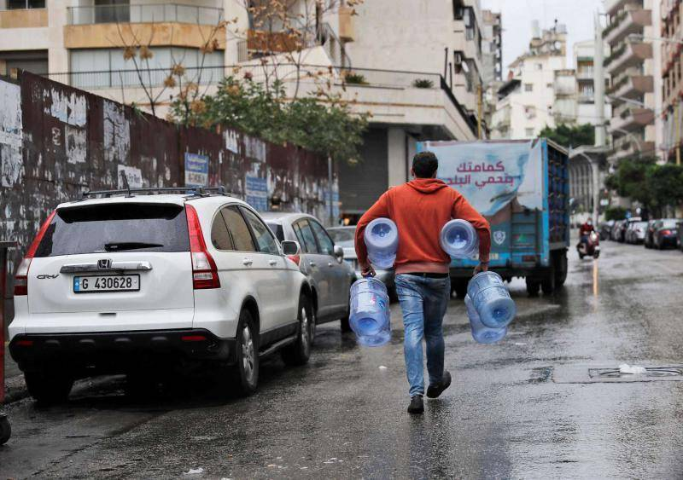
Water Availability
Effective Solutions
Covered Aspects
Water Accessibility and Costs
Effects on various sectors

Slide 9
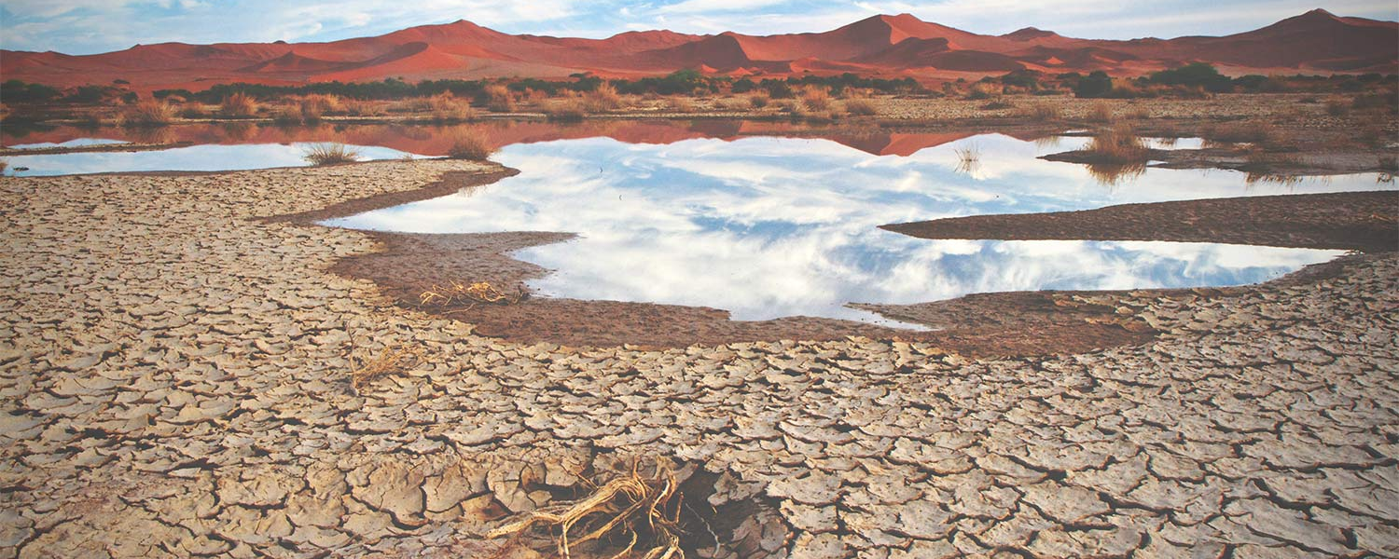
03
Results

Slide 10


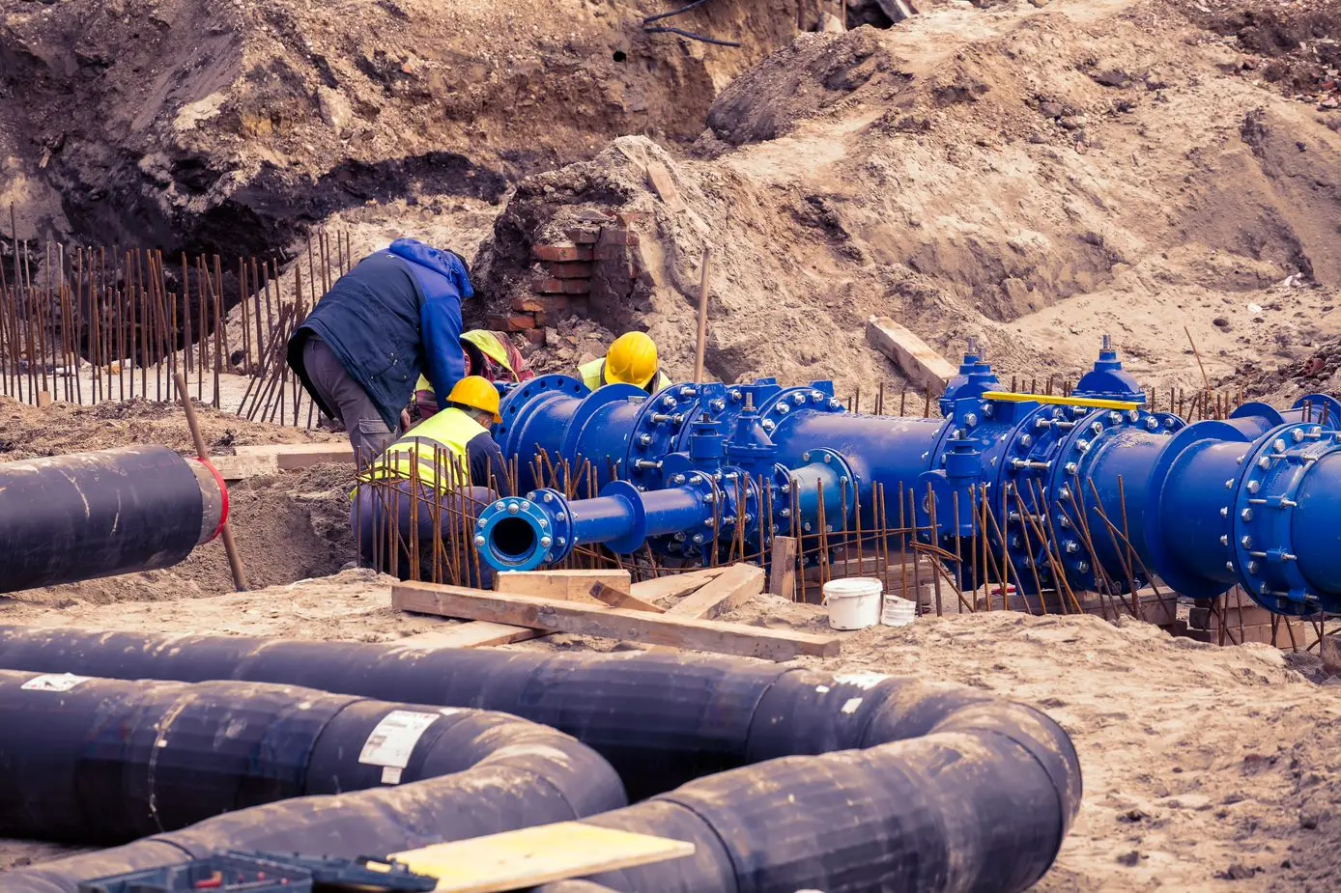
Questions
Water shortages
Primary source
Solutions
33.3% - sometimes
17.8% - always
68.9% - infrastructure
48.9% - policies
37.8% - public supply
28.9% - private well

Slide 11

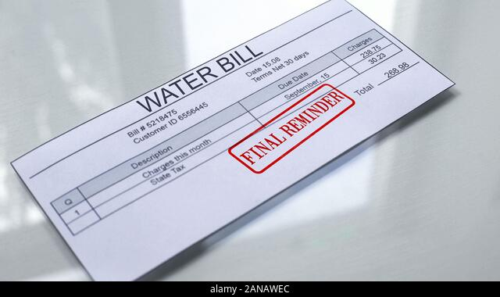

Questions
Impact of refugees
Expenses
Health issues
48.9% - significant
4.4% - no impact
35.6% - experienced
46.7% - significant
13.3% - no increase

Slide 12
04
Discussion

Slide 13
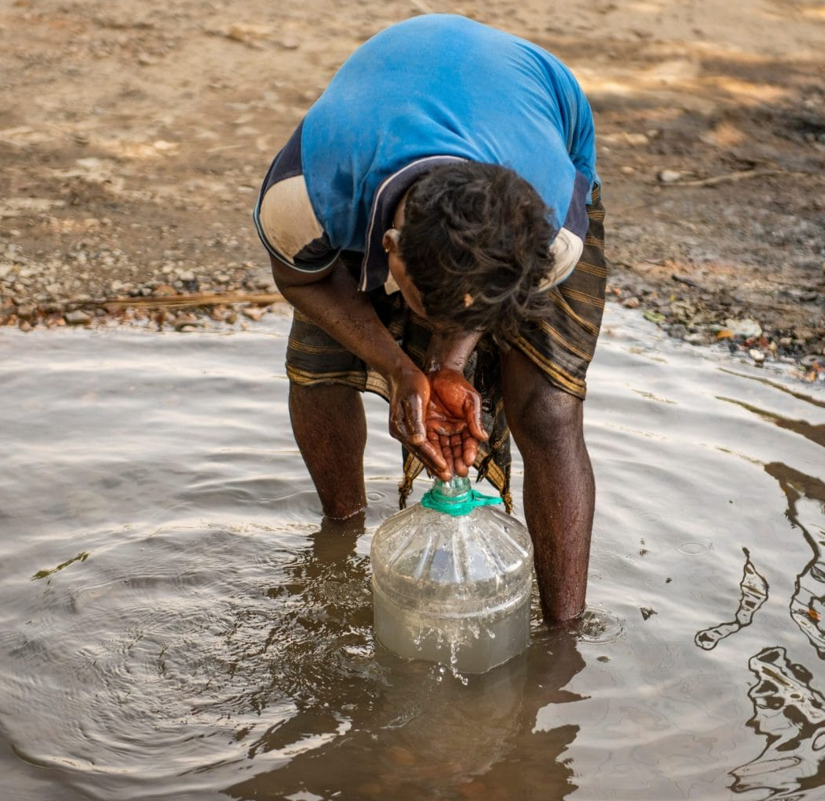
Discussion
The main findings regarding availability and affordability:
Different regions experience scarcity in varying degrees.
Water expenses vary, and for some bypass UNDP threshold.

Slide 14

Discussion
Awareness
Solutions
ç
The considered solutions by the students match the actual implementations.
Population is uneducated on conservation strategies.
A willingness to invest signals fast adoption of new technologies

Slide 15
05
Conclusion

Slide 16
Solutions
Regulate Water Usage in Agriculture
Repair Existing
Water Distribution
System
Household Water Metering and Tariffs
Enforce Water-Efficient Practices in Industries

Slide 17





Recommendations
Funds and Resources
Collaboration
Research
Renewing plans
Sustainable irrigation methods

Slide 18
Questions ?

